Slide 1
EDUCATION
IN BRITAIN & IN RUSSIA
Учитель английского языка Жиляева М.Н.

Slide 2
The more we learn-the more we know
the more we know- the more we forget
the more we forget - the less we know
So why study ?
I go to school because…………….

Slide 3
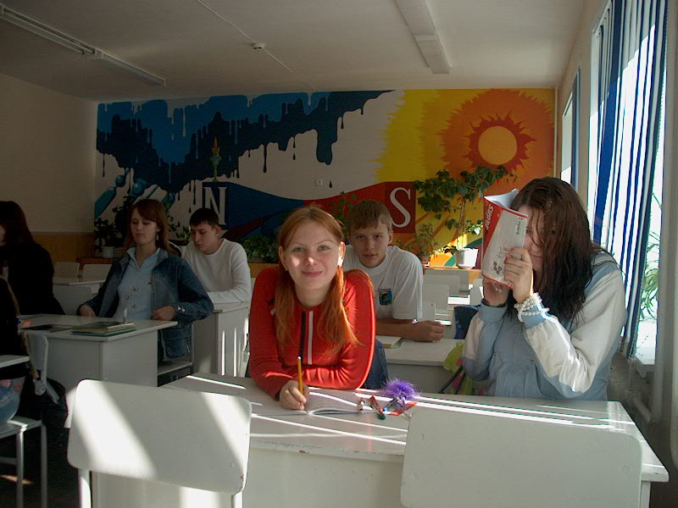
Secondary school

Slide 4
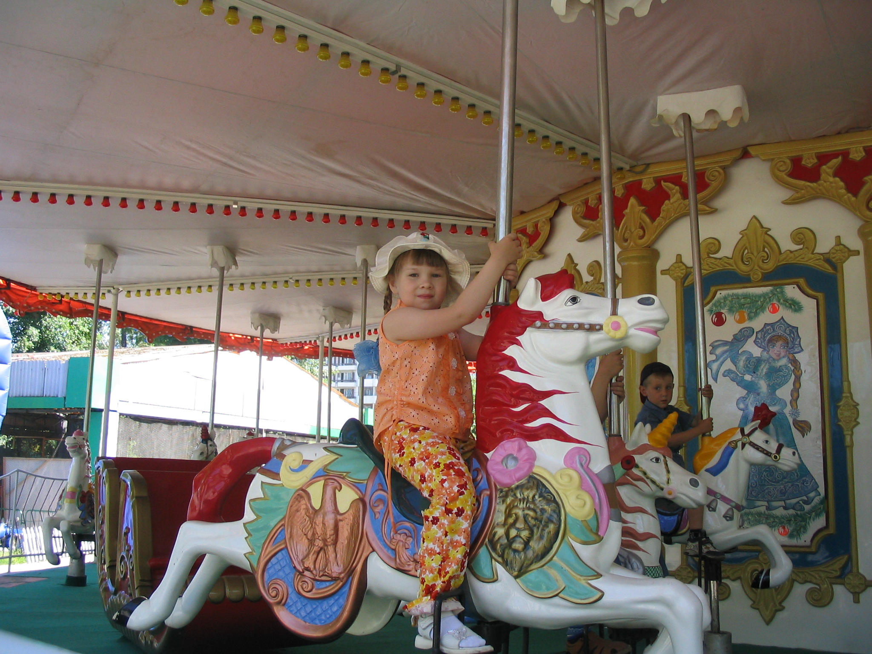
Primary school

Slide 5
1. An idle brain is the devil`s workshop
2. Business before pleasure
3. Deeds, not words
4. Constant dropping wears away a stone
5. Handsome is a handsome does
6. Make hay while the Sun shines
7. Live and learn
8. Practice makes perfect
9. A little learning is a dangerous thing
10. All work and no play makes Jack a dull boy

Slide 6
1. Праздный ум – мастерская дьявола.
Сравнение: Труд человека кормит, а лень портит.
2. Сначала дело, потом удовольствие.
Сравнение: Кончил дело - гуляй смело.
3. Дела, а не слова.
Сравнение: Больше дела, меньше слов.
4. Постоянно падающие капли точат камень.
Сравнение: Терпение и труд всё перетрут.
5.Красив тот, кто красиво поступает.
Сравнение: Не по виду суди, а по делам гляди.
6. Готовь сено, пока солнце светит.
Сравнение: Не откладывай на завтра то, что можно сделать сегодня.
7. Живи и учись.
Сравнение: Век живи, век учись.
* 8. Практика ведёт к совершенству.
Сравнение: Повторение – мать учения.
9. Недостаточное знание опасно.
Сравнение: Недоученный хуже ученого.
10. Одна только работа без забав превращает Джека в тупого ребенка.
Сравнение: Делу время – потехе час.

Slide 7
England has got a very interesting system of education. Education is class-
divided in England . There are some state schools in England . They are infant schools, junior schools & secondary schools.
British boys & girls begin to go to school at the age of 5. They draw pictures , sing songs , play games , listen to stories & tales .
British children begin to read & write when they enter the infant school .
Little children are divided into 2 groups , according to their mental abilities . Children leave infant school when they are 7 years old .They begin to study at junior school where they learn to write , to read & to do mathematics ( maths ) .
Boys & girls have got many interesting school subjects . They are History , English, Geography , Maths ,Art , Music , Sport , Computing , Cooking .
When the pupils enter junior schools , they have a special test . According to the results of the tests & their intellectual abilities they are divided into 3 groups .
Boys & girls study at junior schools for 4 years .
Then they take their examinations & enter the secondary schools .
There are some types of secondary schools in England . They are : grammar schools , modern schools & comprehensive schools .
English boys & girls go to a secondary school from 11 till 16 years old . They don’t go to school on Saturdays & Sundays .
One can attend modern schools , but pupils don’t learn foreign languages at such schools .
If pupils go to grammar schools they’ll have a good theoretical secondary education .The other secondary school is a comprehensive school . Almost all secondary school pupils ( 90 % ) go there .
There are some private schools in England . Boys & girls don’t study together at these schools. The sons of the aristocracy go to public schools & their parents pay much money for their education .
Independent & preparatory schools are private schools too . They prepare pupils for public schools for money .The teachers of the private schools pay personal attention to each pupil .
It is possible to enter the best English Universities after leaving public schools .
After finishing grammar schools pupils have good knowledge & may continue to study in colleges or Universities .
Pupils have school uniforms in England. It is an old tradition in the country .
A boy’s uniform consists of a special suit , a school cap , a tie & a blazer .
A girl’s uniform consists of a hat , a coat , a skirt & a blouse. As usual their uniform is dark .

Slide 8
Find the English equivalents for the following words:
очень интересная система образования
государственная школа
частные школы
общеобразовательные школы
поступить в школу
в соответствии с результатами теста
иметь хорошую теоретическую подготовку

Slide 9
Make a scheme of education:
ENGLISH SCHOOLS
STATE SCHOOLS
INFANT
JUNIOR
SECONDARY SCHOOLS
Modern
Grammar
Comprehensive
PRIVATE SCHOOLS
Independent
Preparatory
PUBLIC SCHOOLS

Slide 10
2. Find the synonyms:
to enter school to have tests
to attend school to go to school
at the age of 5 being 5 years old
to take exams to separate
to divide to come to school
almost to finish school
mental abilities nearly
to leave school intellectual abilities

Slide 11
In England children go to school when they are ..., but in Russia
they usually begin their school education at the age of... .
In England they stay in… school longer than in Russia.
In England primary school has two steps: ... and ..., but in Russia it doesn't.
In England children go to the first form when they are ... but in
Russia they go to the first form at the ... of six or seven.
In England pupils stay in secondary school ... years, but in Russia they stay in secondary school ... years.
In England they take exams after ... and ..., but in Russia ...
English schools have the sixth form for those who want to go
to ..., but in Russia they get ready for ... in the tenth and eleventh ...

Slide 12
READING FOR DISCUSSION
Read, the following text which will help you to discuss how important is knowledge.
KNOWLEDGE IS POWER
You have discussed many English proverbs. Such discussions, as you know, make your knowledge of English better.
Here is one more proverb which is the main problem for today's discussion: "Knowledge is power". This proverb means that the more a man knows, the greater power he has. Knowledge has given man his great power.
You may think that one cannot know everything. It is correct, of course, but everybody must always try to increase his knowledge. You get knowledge at school, from books, magazines, radio and TV programmes.
Knowledge of history helps us to understand the past, the present and the future. If your knowledge of other school subjects is good, it will help you in your future life.
What do people do if they do not know something important for their work or profession?
As a rule, they try to get more knowledge about it. They try to learn and understand what they do not know and try to use it in practical life.
We need knowledge to be more useful for our country.
Questions:
What makes your knowledge of English better? 2. What does the proverb "Knowledge is power" mean? 3. Where do you get knowl­edge? 4. When do people try to get more knowledge? 5. Why do we need knowledge?

Slide 13
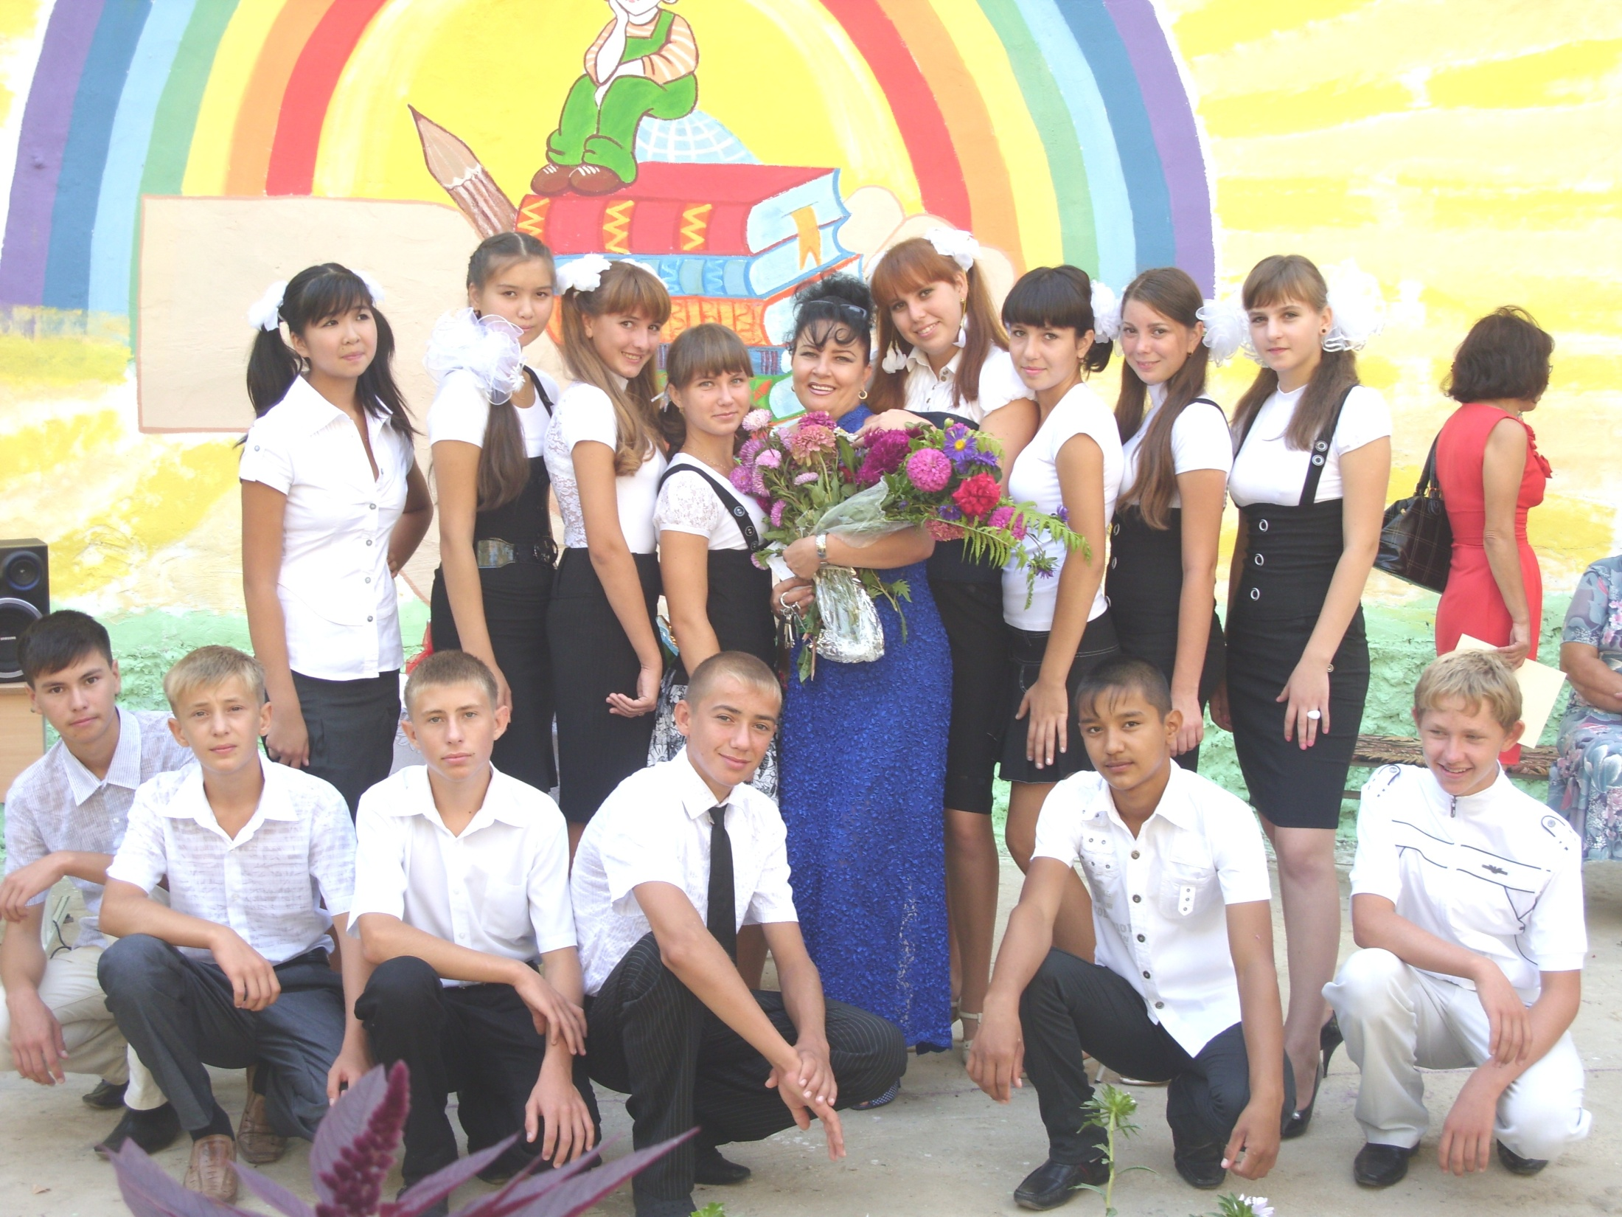
Our school

Slide 14
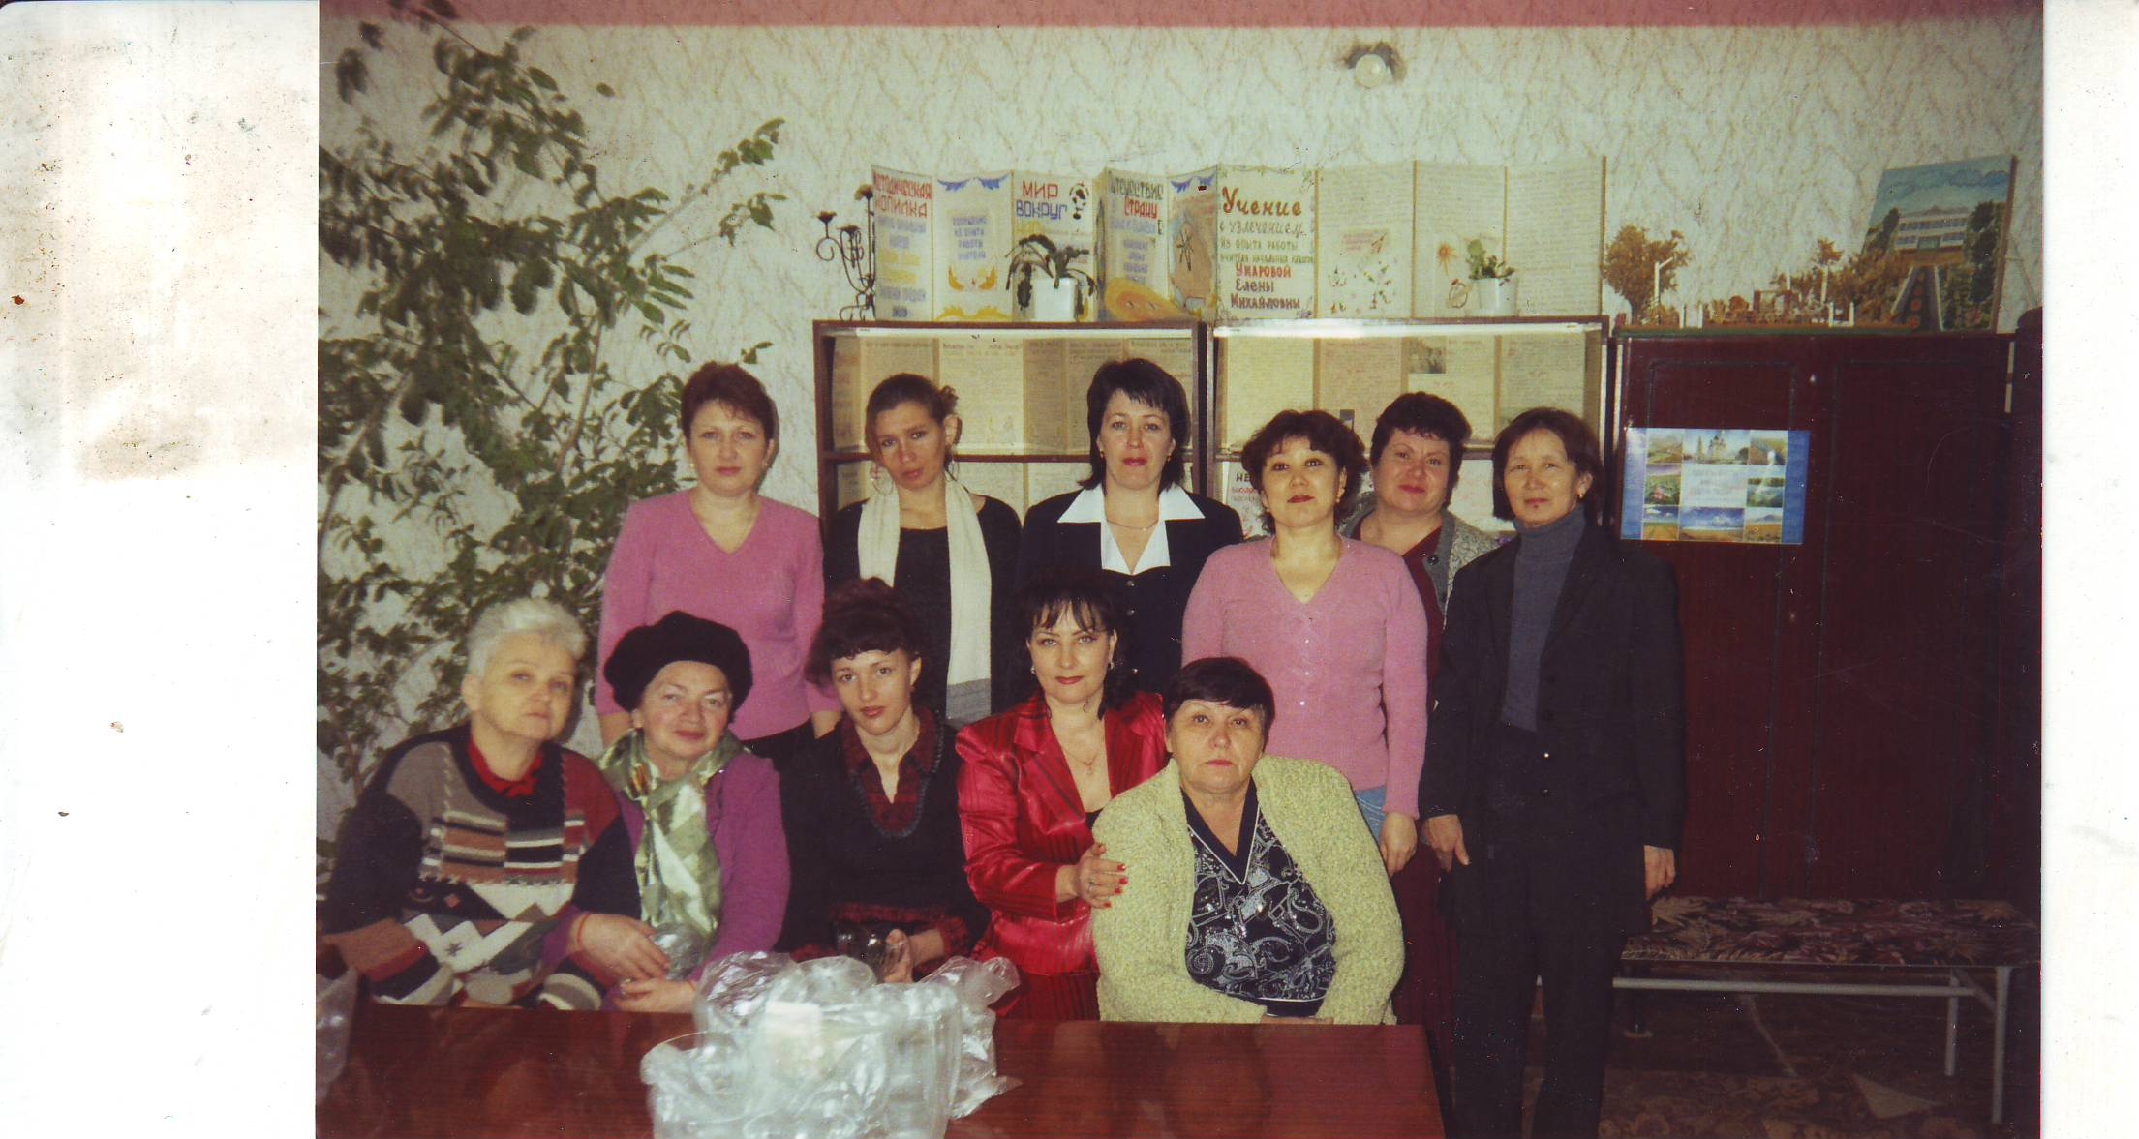
Our teachers are the best !!!

